Slide 1
MongoDB - Practical

Slide 2
Before we begin
RDBMS | MongoDB
Database | Database
Table, View | Collection
Row | Document (JSON, BSON)
Column | Field
Index | Index
Join | Embedded Document
Foreign Key | Reference

Slide 3
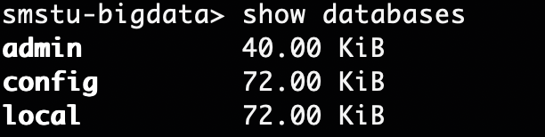
Show Database
Use `show databases` command to list out all the existing database.

Slide 4
Create a Database
To use existing database or create new one, use the command:
use smstu-bigdata
This switches to the database `smstu-bigdata`. If it doesn't exist, MongoDB will create it.

Slide 5
Create a collection
To create a collection, simply insert a document or use:
db.createCollection(‘mongo-collection’)
This should create collection in our selected database. Use `show collection` command to list the collections in a database.

Slide 6
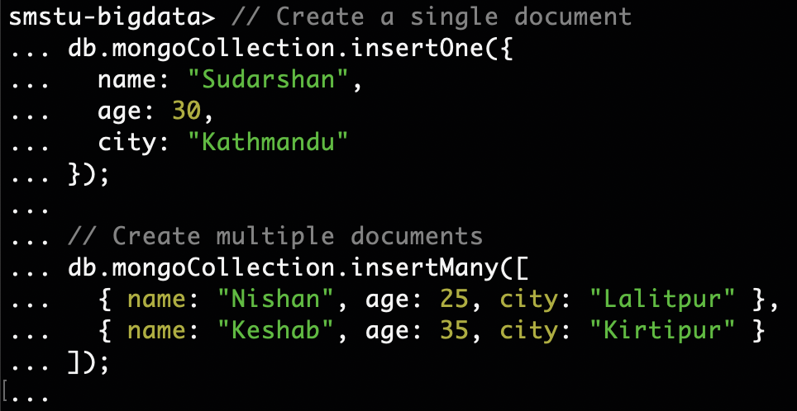
Create Operation
Use the insertOne() or insertMany() method to add documents to a collection.

Slide 7
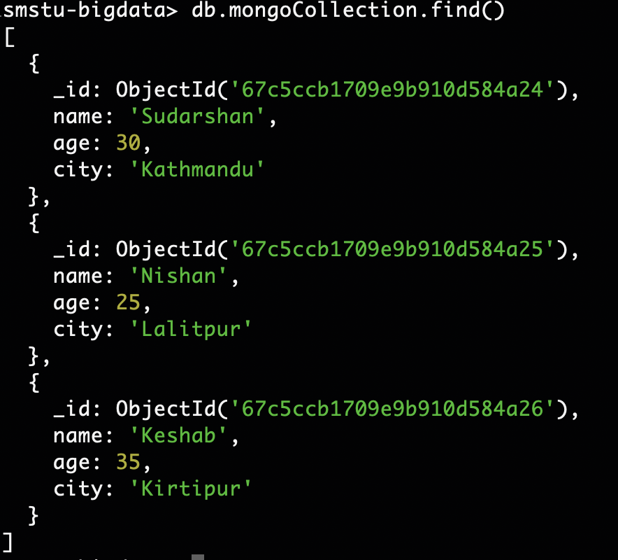
Read Operation
Use find() to select all records.
// Find specific documents with a condition db.mycollection.find({ age: 30 }) // Find a single document db.mycollection.findOne({ name: ”Nishan" })

Slide 8
Update Operation
// Update a single document
db.mongoCollection.updateOne(
{ name: "Sudarshan" }, // filter
{ $set: { age: 31 } } // update
);
// Update multiple documents
db.mongoCollection.updateMany(
{ city: "Kathmandu" }, // filter
{ $set: { city: "Balkhu" } } // update
);

Slide 9
Delete Operation
// Delete a single document
db.mongoCollection.deleteOne({ name: "John" });
// Delete multiple documents
db.mongoCollection.deleteMany({ age: { $gt: 30 } });

Slide 10
Indexing for Performance
MongoDB allows user to create indexes to improve the performance of queries:
db.mycollection.createIndex({ name: 1 }); // Creates an index on the "name" field

Slide 11
Aggregation Pipeline
An aggregation pipeline in MongoDB is a powerful framework that allows you to perform operations on your data, such as filtering, grouping, sorting, and transforming it, in a highly efficient manner.
It is composed of a series of stages where each stage transforms the data as it passes through.
Each aggregation pipeline consists of a series of stages, and each stage performs a specific operation.
The stages are processed in order, with the output of one stage becoming the input to the next.

Slide 12
Aggregation Pipeline
The basic structure of an aggregation pipeline:
db.collection.aggregate([
{ stage1 },
{ stage2 },
{ stage3 },
...
])

Slide 13
Common Aggregation Stages
$match – Filters documents to pass only those that match the given condition(s).
{ $match: { status: "A" } }

Slide 14
Common Aggregation Stages
$group – Groups documents by some field(s) and performs aggregation operations like sum, avg, min, max, etc.
{
$group: {
_id: "$category",
totalSales: { $sum: "$sales" }
}
}

Slide 15
Common Aggregation Stages
$sort - Sorts the documents by specified fields:
{ $sort: { totalSales: -1 } }
-1 indicates descending order. Use 1 to sort in ascending order.

Slide 16
Common Aggregation Stages
$project – Reshapes each document by adding or removing fields.
{
$project: {
product: 1,
totalSales: 1,
_id: 0
}
}

Slide 17
Common Aggregation Stages
$limit – Limits the number of documents passed to the next stage.
{ $limit: 5 }

Slide 18
Common Aggregation Stages
$skip – Skips the specified number of documents.
{ $skip: 10 }

Slide 19
Common Aggregation Stages
$unwind – Deconstructs an array field from the input documents to output a document for each element of the array.
{ $unwind: "$categories" }

Slide 20
Common Aggregation Stages
$lookup – Joins documents from another collection (similar to SQL JOIN).
{
$lookup: {
from: "orders",
localField: "order_id",
foreignField: "_id",
as: "order_details"
}
}

Slide 21
Common Aggregation Stages
$addFields – Adds new fields to documents or modifies existing fields.
{ $addFields: { totalPrice: { $multiply: ["$price", "$quantity"] } } }

Slide 22
Common Aggregation Stages
Say, we have a sales documents:
[
{ "_id": 1, "product": "A", "sales": 100, "category": "Electronics" },
{ "_id": 2, "product": "B", "sales": 200, "category": "Electronics" },
{ "_id": 3, "product": "C", "sales": 150, "category": "Furniture" }
]

Slide 23
Common Aggregation Stages
Calculate the total sales per category, we can use aggregation pipeline as:
db.sales.aggregate([
{ $group: { _id: "$category", totalSales: { $sum: "$sales" } } },
{ $sort: { totalSales: -1 } }
])

